Slide 1
Introduction to System z Security
Lesson 2: The Architecture and Hardware
Notes:
Mainframes have been designed from the very beginning to provide computing resources to concurrent users, a capability which was eventually called “multiprogramming” indicating that the programs scheduled for execution are not serialized in sequence of execution but are called and executed whenever the system resources that each requires are available.

Slide 2
Objectives
Describe at a high level the concepts of Control Instructions, Storage protection, and Interruptions
Explain How they are the foundation to establish a secure environment for multiple concurrent users of the system.
Understand the concepts of machine virtualization, their implementation and the inherent Security exposures
Explain how these Security exposures have been approached in the System z hardware.

Slide 3
Key Terms
z/Architecture
Operating System
Control instructions
Program Status Word (PSW)
Supervisor state
Problem state
PSW key
Interruption
Storage protection key
Virtual storage
Dynamic Address Translation (DAT)
Process Resource/System Manager (PR/SM)
Logical Partition (LPAR)
Symmetric, asymmetric, and one-way encryption
Notes:
z/Architecture
Operating System control instructions
Program Status Word (PSW)
supervisor state
problem state
PSW key
interruption
storage protection key
virtual storage
Dynamic Address Translation (DAT)
z/VM z/VM Control Program (CP)
Start Interpretive Execution (SIE)
Process Resource/System Manager (PR/SM)
Logical Partition (LPAR)
Common Criteria
symmetric algorithms asymmetric algorithms one-way algorithms
Data Encryption Standard (DES)
Triple-DES
Advanced Encryption Standard (AES)
Digital Signature Standard (DSS)
RSA algorithm
Secure cryptographic coprocessor
secure cryptographic coprocessor “domain”
Initial Program Load (IPL)
Master Key

Slide 4
Multiplicity and Security Issues
The System Architecture
  The “behavioral” angle
    “an entity can be said to “trust” a second entity when it makes the assumption that the second entity will behave exactly as the first entity expects”.
  The Physical Architecture
    This is the physical implementation of circuits and firmware that back up the behavioral model
    Machine instructions

Slide 5
Instruction Set
The instruction set architected as part of the hardware design.
  For example: on a System z system, there are instructions for changing the flow of a program. These are the BRANCH instructions. On Intel 80x86 processors, the same type of instruction is a JUMP.
Each instruction in the instruction set has a numerical value. The BRANCH instruction is an 07. When a System z system sees an 07 it knows to extract an address from a register and fetch the instruction at that address in memory. That fetched instruction is then executed.
If a System z system saw a JUMP instruction it would take exception to it, since JUMP isn’t in the architected instruction set.

Slide 6
Instruction Set – Many ways to ADD
Name | Mnemonic | Type | OpCode
ADD | A | RX | 5A
ADD NORMALIZED (long) | AD | RX | 6A
ADD NORMALIZED (long) | ADR | RR | 2A
ADD NORMALIZED (short) | AE | RX | 7A
ADD NORMALIZED (short) | AER | RR | 3A
ADD HALFWORD | AH | RX | 4A
ADD HALFWORD IMMEDIATE | AHI | RI | A7A
ADD LOGICAL | AL | RX | 5E
ADD LOGICAL | ALR | RR | 1E
ADD DECIMAL | AP | SS | FA
ADD | AR | RR | 1A
ADD UNNORMALIZED (short) | AU | RX | 7E
ADD UNNORMALIZED (short) | AUR | RR | 3E
ADD UNNORMALIZED (long) | AW | RX | 6E
ADD UNNORMALIZED (long) | AWR | RR | 2E
ADD NORMALIZED (extended) | AXR | RR | 36

Slide 7
System z Control Instructions
PURGE TLB
RESET REFERENCE BIT EXTENDED
SET ADDRESS SPACE CONTROL
SET ADDRESS SPACE CONTROL FAST
SET CLOCK
SET CLOCK COMPARATOR
SET CPU TIMER
SET PREFIX
SET PSW KEY FROM ADDRESS
SET SECONDARY ASN
SET STORAGE KEY EXTENDED
SET SYSTEM MASK
SIGNAL PROCESSOR
STORE CLOCK COMPARATOR
STORE CONTROL
STORE CPU ADDRESS
STORE CPU ID
STORE CPU TIMER
STORE PREFIX
STORE THEN AND SYSTEM MASK
STORE THEN OR SYSTEM MASK
STORE USING REAL ADDRESS
TEST ACCESS
TEST BLOCK
TEST PROTECTION
TRACE
BRANCH AND SET AUTHORITY
BRANCH AND STACK
BRANCH IN SUBSPACE GROUP
DIAGNOSE
EXTRACT PRIMARY ASN
EXTRACT SECONDARY ASN
EXTRACT STACKED REGISTERS
EXTRACT STACKED STATE
INSERT ADDRESS SPACE CONTROL
INSERT PSW KEY
INSERT STORAGE KEY EXTENDED
INSERT VIRTUAL STORAGE KEY
INVALIDATE PAGE TABLE ENTRY
LOAD ADDRESS SPACE PARAMETERS
LOAD CONTROL
LOAD PSW
LOAD REAL ADDRESS
LOAD USING REAL ADDRESS
MODIFY STACKED STATE
MOVE PAGE (Facility 2)
MOVE TO PRIMARY
MOVE TO SECONDARY
MOVE WITH DESTINATION KEY
MOVE WITH KEY
MOVE WITH SOURCE KEY
PROGRAM CALL
PROGRAM RETURN
PROGRAM TRANSFER
PURGE ALB

Slide 8
Multiplicity and Security issues Cont’d
Some considerations on data, users, program, etc…
  Data: At any moment in their lifetime, data should remain related to their owners via a pointer.
  Users: Users are materialized in the system by tasks to be executed on their behalf.
  Programs: Are actually data, and should be considers as such until they are fed into memory for execution.

Slide 9
Multiplicity and Security issues Cont’d
Where all programs are not made equal
  Control Instructions: Have the capability of affecting the user execution environment.
    Should be made available to the OS only
  General Instructions: Can be executed by any program.

Slide 10
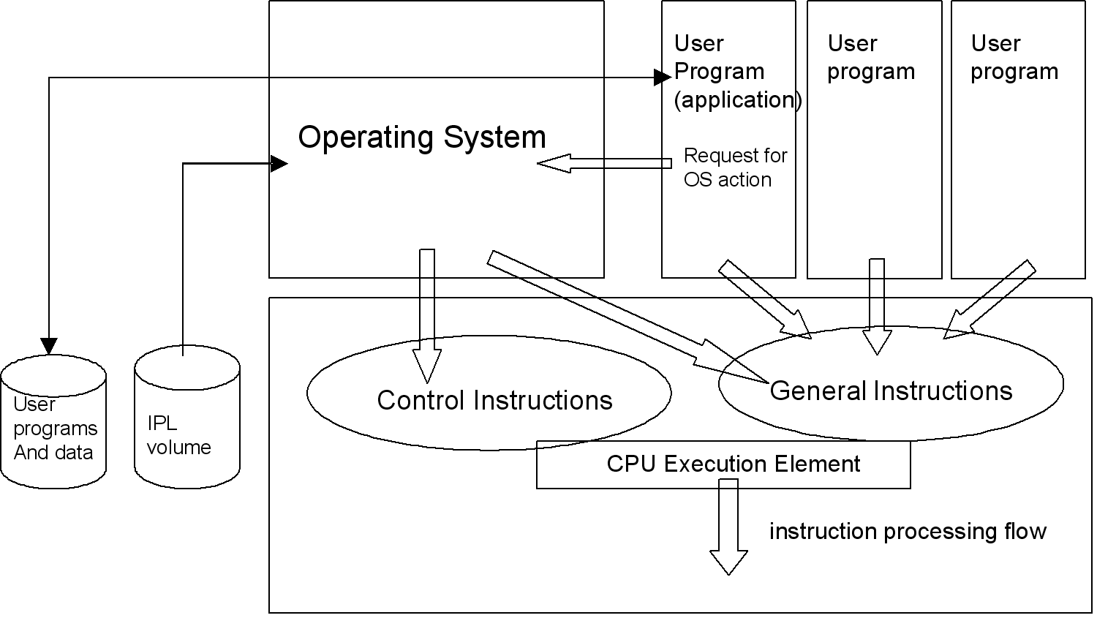
Instruction Execution

Slide 11
Program Status Word (PSW)
The Program Status Word (PSW)
  The current program-status word (PSW) in the CPU contains information required for the execution of the currently active program. The PSW is 128 bits in length and includes the instruction address, condition code, and other control fields. In general, the PSW is used to control instruction sequencing and to hold and indicate much of the status of the CPU in relation to the program currently being executed. Additional control and status information is contained in control registers and permanently assigned storage locations.
  The status of the CPU can be changed by loading a new PSW or part of a PSW. Control is switched during an interruption of the CPU by storing the current PSW, so as to preserve the status of the CPU, and then loading a new PSW.
  Execution of LOAD PSW or LOAD PSW EXTENDED, or the successful conclusion of the initial-program-loading sequence, introduces a new PSW. The instruction address is updated by sequential instruction execution and replaced by successful branches. Other instructions are provided which operate on a portion of the PSW.

Slide 12
Interrupt Driven Systems
Systems running on System z processors are interrupt driven
  When events occur in the system, execution of the program on the processor is paused and the event is handled
Types of events that cause interruptions:
  Restart
  Supervisor-Call
  External
  I/O
  Machine-Check
  Program

Slide 13
The Interruption Mechanism
When an interruption event occurs, the program status word (PSW) is changed in favor of a PSW which drives the interrupt handling software.
This requires some strict conventions and preparation to happen.
  The new PSW is fetched from memory locations fixed by the z/Architecture.
  The Operating System prepares the new PSWs so that the proper instruction sequences are given control when the interruption occurs.
  The interrupted program eventually regains control when the OS retrieves the “old PSWs” from the architecturally defined location where it was stored.
The process flow of an interruption:
A user program is executing
  An I/O interruption event occurs. We can assume that a preceding process initiated an I/O operation which is now signaling its conclusion.
  The CPU hardware detects the I/O interruption condition and stores the current PSW into a fixed memory location as the ”I/O old PSW”.
  The CPU hardware loads the I/O new PSW that gives control to the Operating System I/O interrupt handler module.
  The I/O interrupt handler does whatever processing is needed, and when done it performs a LPSW instruction giving the fixed memory address of the I/O old PSW.
  Thus the user program resumes processing at the point it has been interrupted.

Slide 14
Compartmenting the System z computer memory –
The Storage Protection keys.
The Storage Key principles of operation
  Every page frame is allocated a “Storage Key” which consists of a set of four bits called the “Access-Control bits” plus an additional bit called the “Fetch Protection bit”. The Storage Key is physically located in associated system-only memory, that is storage keys and Fetch protection bits are not accessible as regular memory data by instructions.
Getting the Storage Protection Keys to work
  A control instructions allows to set a Storage key value, that is a specific value out of 16 possible values, for a given page frame.
  There is also a PSW key value that can be set in bits 8 to 11 of the PSW. When an instruction being executed in the CPU requests for memory access, the hardware compares the Storage Key and the current PSW key values before proceeding with any effective access.
  When the memory access is denied the requesting program is interrupted. The Storage protection Key violation event falls in the category of Program-check interrupt. It is typically expected that in such a case the operating system is not to resume the execution of the interrupted program, as it is either an addressing mistake in the user program or the user program deliberately attempts to penetrate memory areas it is not authorized to access.

Slide 15
Getting more complicated: the multiprocessing environment
Today’s systems have several CPUs sharing the same memory and therefore sharing the same single instance of the operating system and user programs. This configuration is called a tightly-coupled multiprocessing system.
From the Security standpoint a multiprocessing configuration still exploits the basic schemes of control instructions and hardware interruptions. However there is another degree of complexity brought by the multiplicity of concurrent processing units accessing the same memory. For instance, memory accesses from multiple requestors have to be serialized.
Some memory operations must be guaranteed to be “atomic” operations, meaning that nobody else gets access to the data being worked on until the operation is complete. The z/Architecture specifies in which cases such an atomicity can be expected from the system.

Slide 16
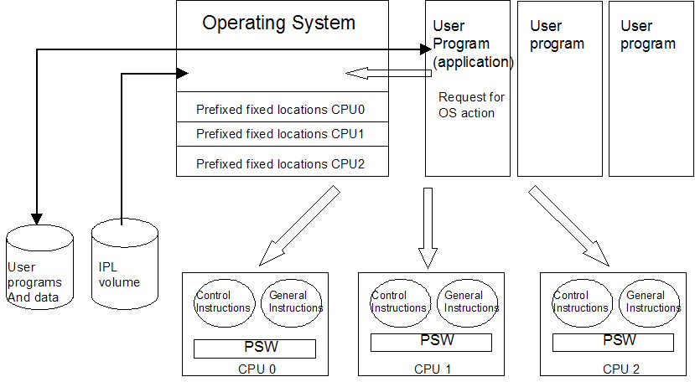
Multiprocessing

Slide 17
Virtualization
Virtualization of the computing environment took form as another layer of software between the user operating system and the physical hardware of the system.
A “hypervisor” presents to the user’s operating system a somehow better fitted virtual environment than the physical system could possibly offer.
In this hierarchy of Operating Systems the user’s OS manages the execution of the user’s workload exploiting the virtual resources.
The hypervisor manages the mapping of these virtual resources to what is physically available on the system.
Virtualization also implicitly offers the capability of duplicating the virtualized environments so that several user Operating Systems can run concurrently on the same physical system.
Each one of these virtual environments can be seen as a virtual machine that behaves, from the end user standpoint, exactly the same as a real machine.

Slide 18
Challenges to virtualization
There are two main challenges when implementing virtualization:
  keeping performance, as seen by the end user, at its best. Which implies that virtualization implementation has to be much clever than simple software simulation. This puts requirements both on software design of the hypervisor and internal hardware mechanisms.
  From the security standpoint: maintaining proper isolation between virtualized environments so that they actually behave like separate machine as seen by the end user. This requirement, and other operational considerations, lead to implement, at the hypervisor level, a control of access to physical resources by the virtualized environments.

Slide 19

Virtualized environment
Virtualized environment 1 - Memory
Virtualized environment 2 - Memory
User
Program
(application)
User
program
User
program
User
Program
(application)
User
program
User
program
Operating System
Request for
OS action
Operating System
Request for
OS action
Contol instructions
Contol instructions
hypervisor
Virtual CPU
Virtual CPU
Virtual CPU
Possible simulation
of control instruction
Possible simulation
of control instruction
Possible simulation
of control instruction
User
programs
And data
IPL
volume
Virtualized environment 1
Control Instructions
General Instructions
CPU Execution Element
User
programs
And data
IPL
volume
Virtualized environment 2
PSW
instruction processing flow
Virtual hardware
console
Physical CPU

Slide 20
System z Virtual Storage
The concept of virtual storage
This physical mapping is transparent to programs in that programs use the memory address in a purely conceptual view: programs designers are expecting that:
  an address used to store data is also the address to be used to retrieve these same data.
  contiguous address values point at contiguous data.
Address values as used by programs can be decoupled from actual physical addresses used by the memory technology. Such a decoupling would allow
  better use of the available space in the physical memory, which then became the “real storage”
  programs ranges of “logical addresses” that would go beyond the actual limit of real storage. The “logical address” being the address used by the CPU to fetch the instructions to be executed, to fetch the data to be worked on and to store the results of instructions execution.
  inter-user isolation at the virtual storage level.
The term “Virtual Storage” was coined to designate the capability, offered by a system, to use logical addressing.
This led to the implementation of a “Dynamic Address Translation” (DAT)
Notes:
Data located in computer memory is retrieved using an “address” pointer. Since the first days of random memories technology, the value of a memory address was directly mapped by the addressing hardware to the physical cell in storage that contains the byte of data.

Slide 21
Dynamic Address Translation
Virtual storage implementation in System z uses both hardware and software mechanisms. DAT is a hardware mechanisms that, as the name implies, translates on the fly a logical address provided by the CPU to a real storage address.
However DAT relies on translation tables prepared in advance by the Operating System.
A few points here:
Translation tables contents are managed by the Operating System. All instruction dealing with their management are Control Instructions.
Storage Protection keys still apply to real storage page frames
The translation tables are specific to each user environment.

Slide 22
Logical Partitioning
PR/SM (processor resource/systems manager) is a standard feature of System z that allows the user to define “logical partitions” (LPARs) in the physical system.
A logical partition provides the set of resources necessary to load an execute an Operating System and users applications.
A single physical System z system can host several Operating Systems that operate concurrently under control of the PR/SM microcode and hardware mechanisms.
Each logical partition appears as a complete system to its users and administrators.

Slide 23
Sharing LPAR Resources
The set of resources made available to a logical partition is made of:
  physical memory - Each logical partition has its own piece of the physical system memory. There is a strict separation between the physical address ranges provided to each partition.
  CPU - typically the physical CPUs are being shared between the logical partitions. That is, on a time sharing basis, each LPAR has a piece of its instruction stream executed by the physical CPU.
  I/O channel paths - I/O channels can be dedicated to logical partitions, or on the contrary can be shared, still on a time sharing basis, between logical partitions. An LPAR can have a mixed set of dedicated and shared channels. This includes the sharing of the OSA (Open System Adapter) network adapter and the hipersocket facility in PR/SM.
  Optionally the hardware cryptographic coprocessors can also be shared between logical partitions.

Slide 24
Encryption – A Must Today
The major Security objectives when dealing over non-secure networks, as it is the case today with TCP/IP networks such as the Internet, can be expressed as:
  authentication
  data integrity
  data confidentiality
  non-repudiation
they can be achieved with proper reliability only by using cryptography. For instance “strong” authentication is not performed using a password that can be easily stolen or guessed but by proving instead that one possesses a secret cryptographic key.

Slide 25
The cryptographic algorithms in use today
There are roughly three families of algorithms in use today:
  symmetric
  asymmetric
  one-way

Slide 26
The symmetric algorithms
The name “symmetric” implies that the same key is used to encrypt and to decrypt the data. One can think of the decryption process being the same as the encryption process, but run “backward”.
The most well know algorithms in use today in the Industry are the DES (Data Encryption Standard) algorithm, which uses a key of 56-bit long, the Triple-DES algorithm with a key of 168-bit long and the AES (Advanced Encryption Standard) with a key length up to 256 bits.
Note that the computations involved in these algorithms are themselves publicly known, however the sequences and parameters used for these computations are derived from the value of the secret key.
These algorithms are also known as “shared secret key” algorithm.

Slide 27
The asymmetric algorithms
The asymmetric algorithms work with a pair of keys, as opposed to the symmetric algorithms which are needing only one key. Using an asymmetric algorithm, what has been encrypted with one key of the pair can only be decrypted with the other key of the pair, whatever the key, out of the two, chosen for the encryption.
For the intended use of these algorithms, the users need to have on key pair and are keeping one key secret (their “private key”) and make the other key of the pair a known value to whoever needs it (this is now the “public key”).

Slide 28
The one-way algorithms
“One-way” indicates that these algorithms are producing encrypted data that are not intended to be decrypted. Actually these are the cryptographic check sums.
A check sum, also called “message digest”, is a fixed length binary value which is obtained when submitting a message to the one-way algorithm. Changing one character in the message results in changing the value of the check sum, it is also said that a check sum is the “fingerprint” of a message.
To verify the integrity of a received message one can compare the checksum that accompanies the message with a new checksum generated when receiving the message.
If both checksums are equal the message went un-tampered between the issuer and the recipient.

Slide 29
Summary
Security is a major design and implementation point in the System z machine hardware. The behavioral model described by the z/Architecture provides the machine instructions and facilities that the Operating System needs to preserve the users data integrity and privacy.
We have discussed virtualization and its implementation through.
  Virtual storage
  Dynamic Address Translation
  Logical Partitioning, PR/SM, and LPARs
As the System z provides also several forms of virtuaIized environments, we explained what are the related challenges to face from the Security standpoint and how they are met both at the hardware and software levels.
As the use of cryptography becomes a basic requirement in today’s world, it is vital to understand the different mechanisms available to computer users.
We described what are the hardware cryptographic facilities that are available on System z and the different types of encryption algorithms used by throughout the industry.

